Slide 1


A Minor Project Report on
“BRAILLE PRINTING MACHINE”
Team 8
Presented by:
VIVEKANANDA HEBSUR | 01FE20BME010
SIDDU S HEBALLI | 01FE20BME034
NAVEEN F WALMIKI | 01FE20BME037
SHANMUKH A CHINMALLI | 01FE20BME050
NAGRAJ V BELUR | 01FE20BME096
PRAKASH D BIDARAKUNDI | 01FE20BME106
Under the Guidance of
Prof. SHIVAPRASAD MUKHANDMATH
Prof. NAGRAJ EKABOTE
Prof. SHRIDHAR MANDAL
School of Mechanical Engineering
K.L.E Technological University,
Vidyanagar, Hubli
23-May-2023
2022-2023

Slide 2
TABLE OF Contents:
Problem Statement
Product Benchmarking
Objective Tree
Morphological Chart
Design Alternatives
Pugh Chart
Assembly CAD Model
Design Calculations
FEM Analysis
Circuit Diagram
Electronic component used
Final Product Photos
Product Catalogue

Slide 3
PROBLEM STATEMENT:
Design and develop an efficient and affordable Braille printing machine that empowers visually impaired individuals by providing them with access to printed information in Braille format, promoting inclusivity and independence in education, employment, and daily life activities.
END USERS:
Visually impaired individuals.
Educational institutions.
Libraries.
Organizations for visually impaired.
Businesses and workplaces.
Individuals and families.

Slide 4
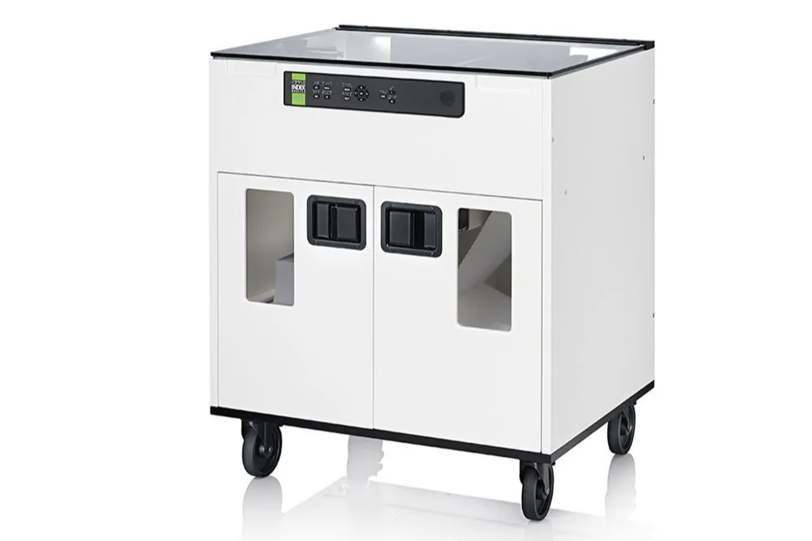
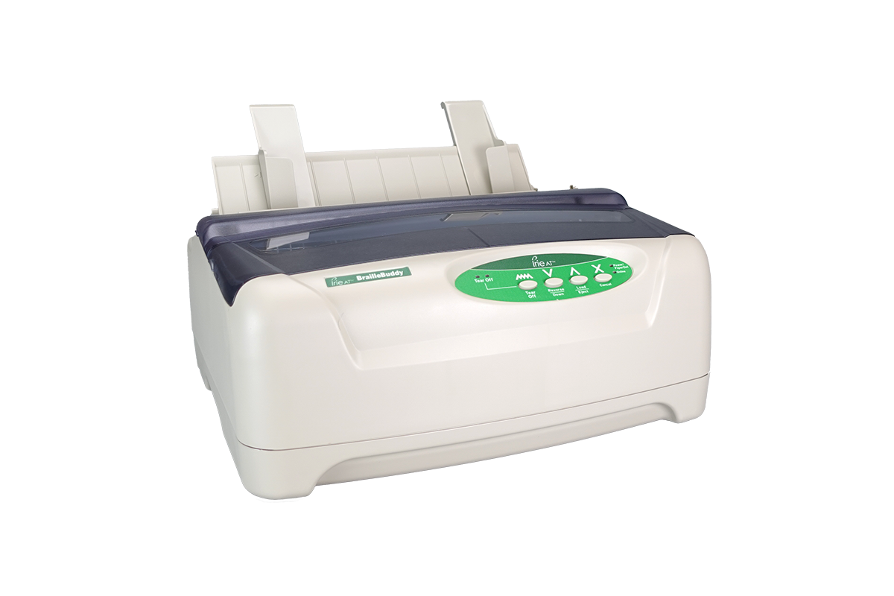
Product Benchmarking
SL.NO | IMAGE OF BRAILLE MACHINE | INFORMATION OF BRAILLE MACHINE
1 | Human ware D V5 tractor fed | With best-in-class indexing technology, the Fanfold-D V5 is a high-speed, tractor-fed embosser that combines excellent dot quality, low maintenance, and high maneuverability. It is the ideal choice for producing large quantities of braille and commercial print materials.
2 | IRIE Braille Buddy | The IRIE Braille Buddy is not only the most affordable braille embosser on the market but also the most versatile! With quality single-sided braille, high-resolution graphics and the ability to use both tractor and cut-sheet paper, the IRIE Braille Buddy is the ideal braille embosser for the everyday user

Slide 5
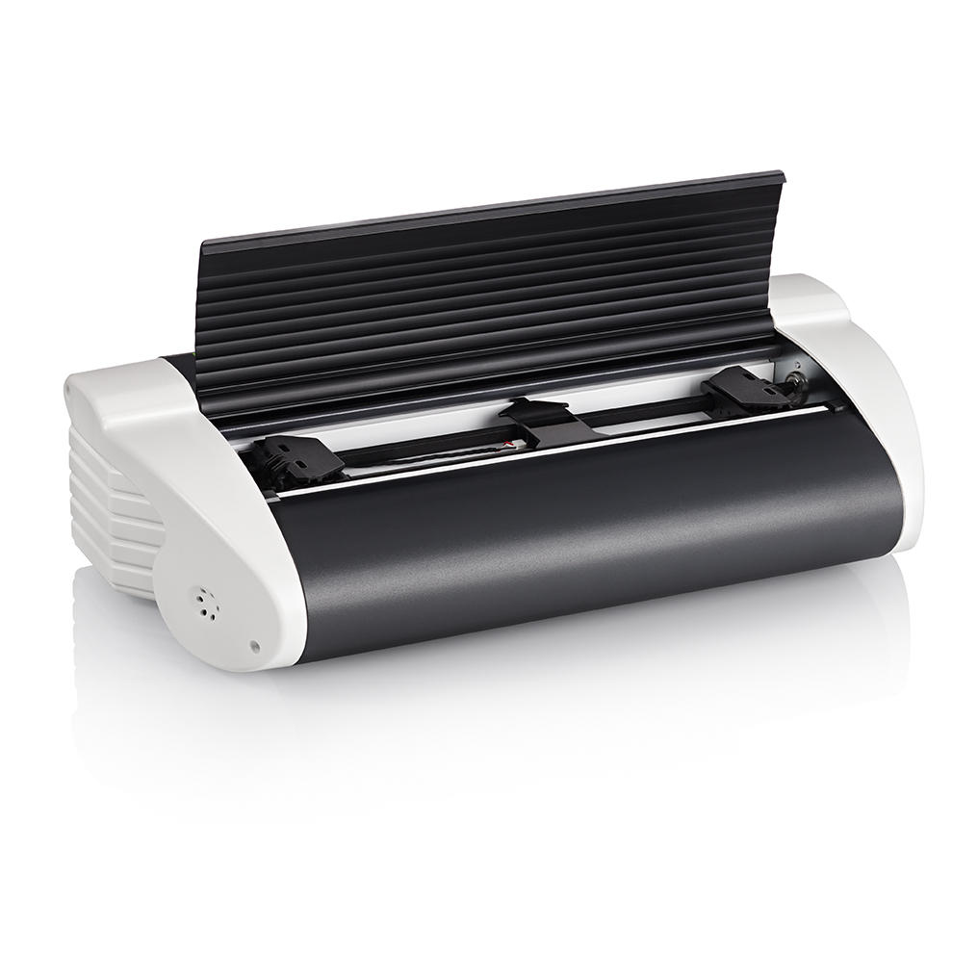
3. | Index Braille Basic-D V5 | Double sided braille 140 characters per second Dot forming height 0,58 mm Braille and text labeled control panel Tractor-fed paper​

Slide 6
Objective Tree
O# | Objectives | First level objectives | Second level objectives
1 | Creation of braille cells | Six dot cells. Eight dot cells.
2 | Accuracy of braille cells. | Grade 1 braille Grade 2 braille | Uncontracted (only common alphabets) Contracted(Numbers, punctuation etc)
3 | Should support modern education. | Reading and Writing Easy to communicate
4 | It should be accessible. | Should be easily available User friendly
5 | Communication between man and braille typewriter. | QWERTY keyboard Braille keyboard Voice recognition Image recognition
6 | Affordable. | Lesser cost Fulfil customer needs

Slide 7
Morphological Chart
Functions ▼ | Means► | Means 1 | Means 2 | Means 3 | Means 4 | Means 5
Hold paper |  | By manually | load roll paper | Hammer mechanism | Braille slate
Braille type writer on(POWER SUPPLY) |  | AC | AC Rectifier | Battery | USB
Alignment of paper |  | Paper feed mechanism | Upper case position | Lower case position
Providing input |  | By laptop/computer | Via WIFI | Voice recognition | Scanning mechanism
Reading input |  | By Arduino code | C language | Python
Normal to braille letters. |  | Braille code | Braille translators
Holding of stylus |  | C-Clamp | Linear servo mechanism | Lifting clamp
Movement of stylus |  | Servo motor | Stepper motor | Belt drive | Chain drive | DC Motor
Printing / Pressing method |  | Pointer moving Towards first braille cell. | Manually paper moving | Offset printing method
Maintaining constant speed |  | AC motor | DC motor | Stepper motor | Servo motor
Paper for printing braille letters |  | GSM 11*9 | Aluminum foil sheet | Bond sheets
Display of braille letters |  | OLED display | LCD display

Slide 8
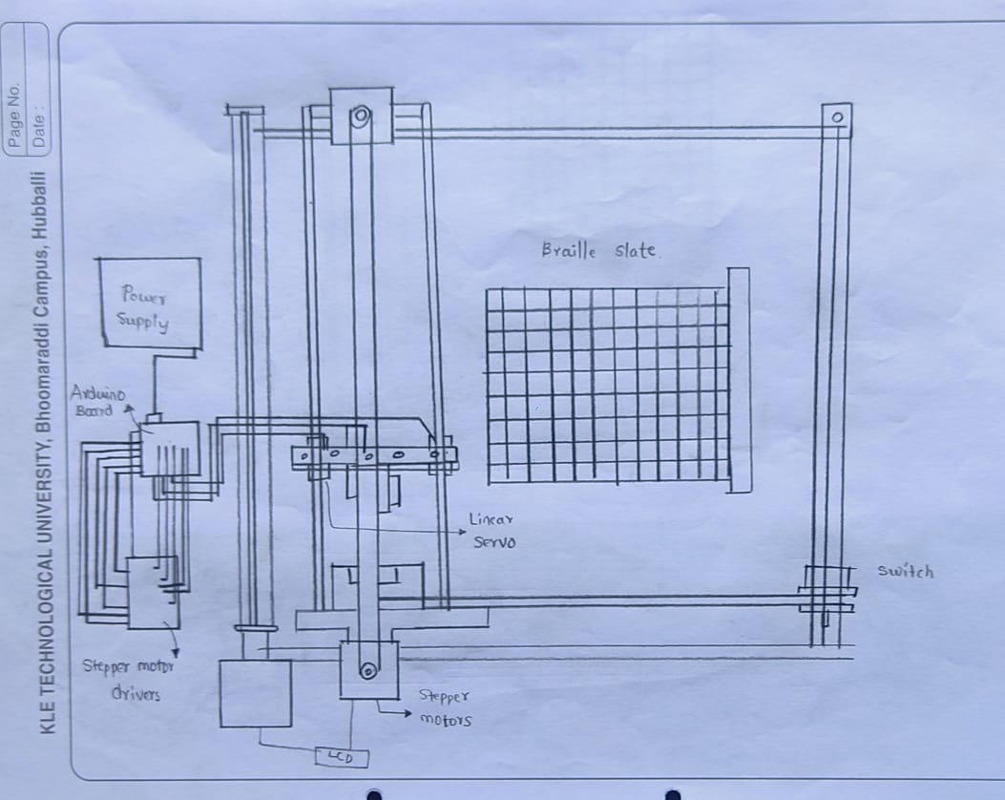
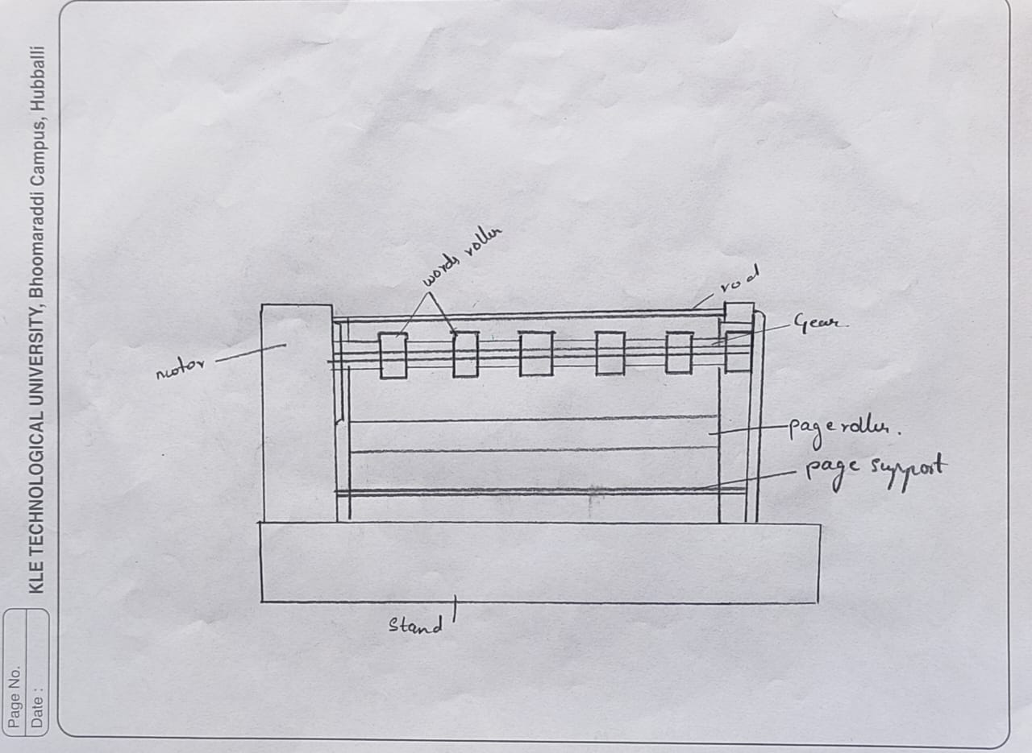
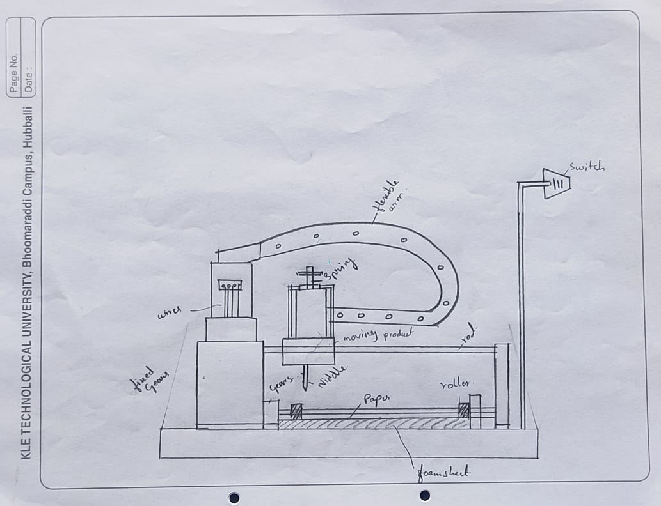
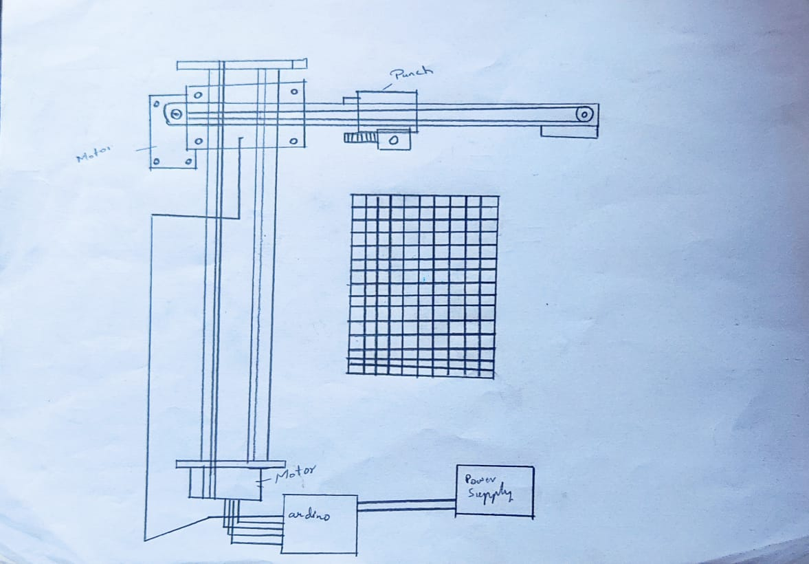
Design Alternatives
Alternate 1
Alternate 2
Alternate 3
Alternate 4

Slide 9
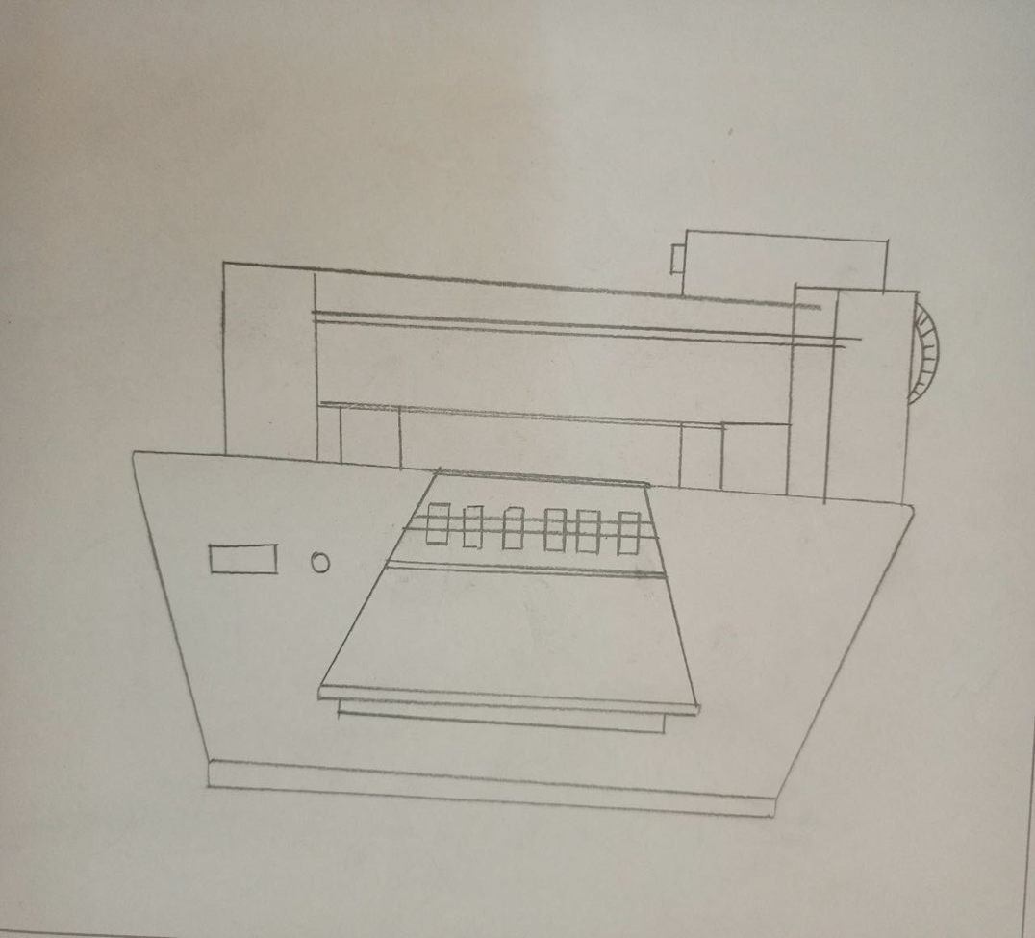
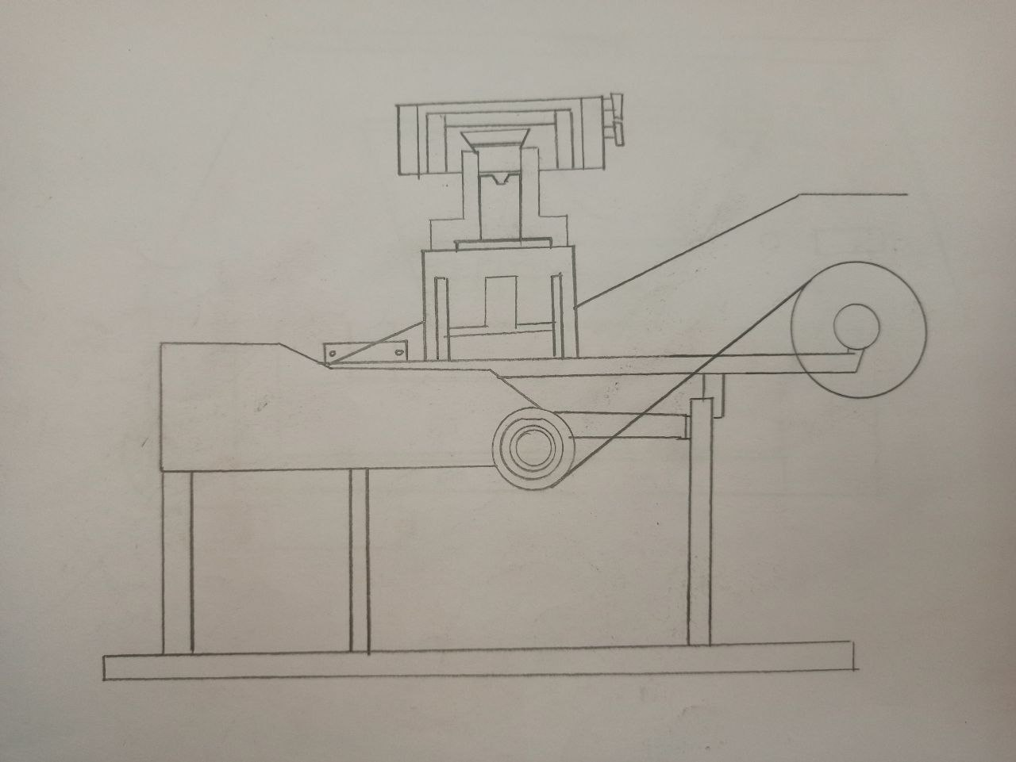
Alternative 5
Alternative 6

Slide 10
Pugh Chart
Requirements | Weight | Design1 | Design2 | Design3 | Design4 | Design5 | Design6 | Reference (blista braille typewriter)
Portable | 7 | + | + | + | + | + | - | 0
Economical | 8 | - | - | + | + | - | - | 0
Efficiency | 8 | + | + | + | - | + | + | 0
Accuracy | 8 | + | + | 0 | 0 | + | - | 0
Light weight | 8 | - | - | + | + | - | - | 0
Safety | 9 | + | + | + | + | 0 | + | 0
Aesthetic | 8 | + | + | - | - | + | + | 0
User friendly | 8 | - | 0 | + | + | + | + | 0
Durability | 7 | 0 | + | + | + | + | + | 0
Pluses |  | 6 | 6 | 7 | 6 | 6 | 5
Same's |  | 1 | 1 | 1 | 1 | 2 | 0
Minuses |  | 3 | 2 | 1 | 2 | 4 | 4
Overall Total |  | 40 | 47 | 55 | 47 | 46 | 40
Weighted Total |  | 16 | 31 | 47 | 31 | 30 | 09 | 0
Yes / No

Slide 11
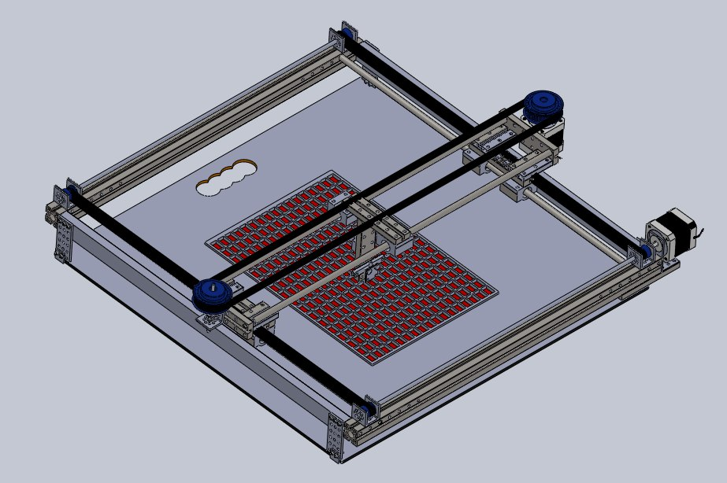
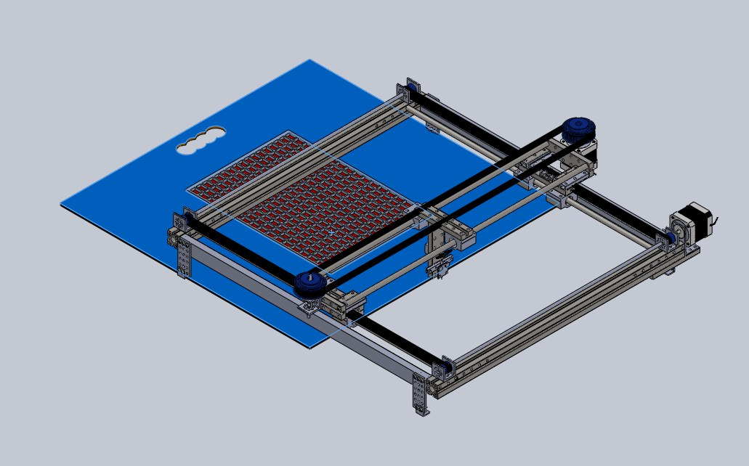
Assembly CAD Model

Slide 12
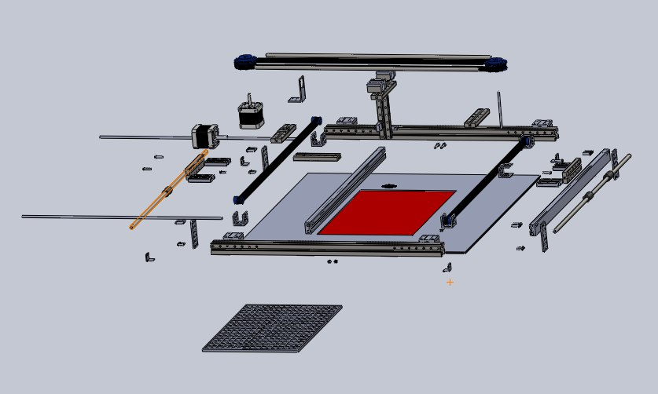
Assembly CAD Model (Exploded view)

Slide 13
Design Calculations
1) STEPPER MOTOR:
How many pulses to move 3’’?
Screw pitch=0.2inch
i.e., 1 rotation=0.2inch
=3inch*(1Rev/0.2inch) *(2000pulse/Rev)
=30,000 Pulses. (To travel 3’’ 30,000 Pulses required)
CROSS CHECK: Can our controller handle that?
=30,000pulses/1.5 sec
=20,000pulses/sec.(For the motor driver productivity 2000 it can withstand 1,00,000pulses/sec)
So, our motor driver is MICRO STEPDRIVER TB6600.
Positioning accuracy.
=(0.2inch/Rev) *(1Rev/2000Pulses)
=0.0001inch/pulses. (Controller sending 2000Pulses per revolution)

Slide 14
Design Calculations (contd..)
Max Motor speed.
=3inch*(1Rev/0.2inch)
=15Rev. (We need 15 revolutions to move 3 inches)
We assume this can be achieved in 1.5sec.
=15Rev/1.5sec
=10RPS.
TORQUE CALCULATION:
To calculate the torque we need to know the weight of the components which is hanging on stainless steel bar.
Weight of braille pen or stylus=5gms.
Weight of braille pen holder=100gms
Weight of linear servo motor=1500gms
TOTAL=1605gms.
M=1.6Kg g=9.81m/s^2.
F=M*g=1.6*9.81=15.68N.

Slide 15
Design Calculations (contd..)
Diameter of SS bar=8mm.
Torque=F*R=15.68*4*10^ (-3) =0.067Nm.
NEMA17 STEPPER MOTOR has Max of 0.4Nm torque. So, we conclude that our stepper motor is NEMA 17 STEPPER MOTOR.
2) BATTERY CALCULATION:
NEMA 17 STEPPER MOTOR works with a voltage of 12v and current of 2A.
So, POWER=VOLTAGE *CURRENT
P=12*2=24W.

Slide 16
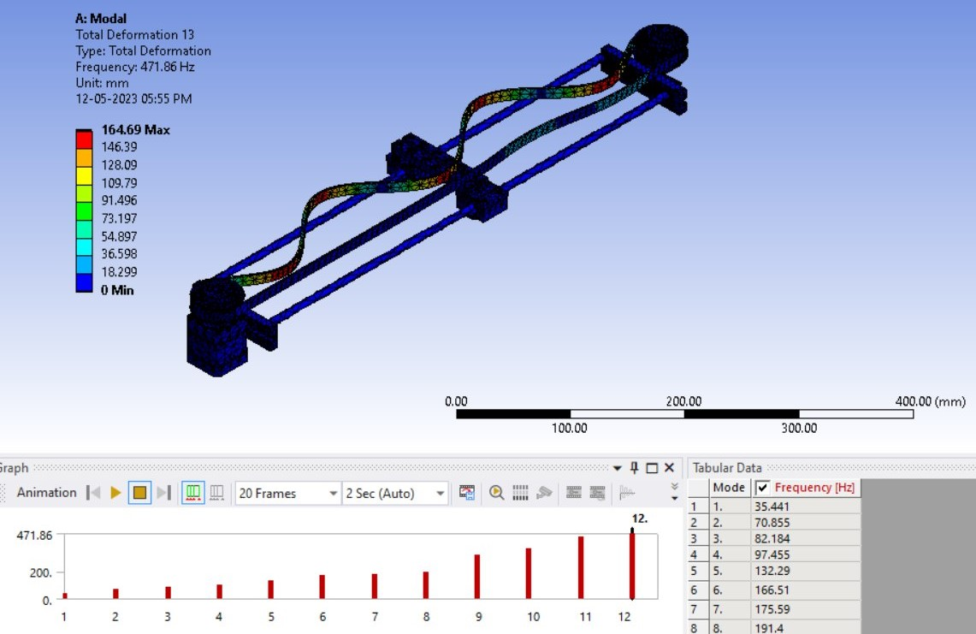
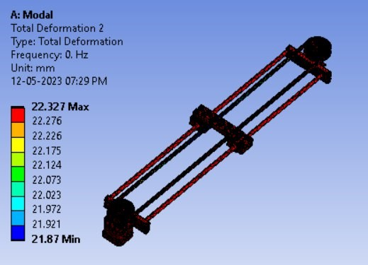
FEM ANALYSIS OF CRITICAL PARTS:
We have observed in this project Belt and pulley as the critical parts, All other parts are undergoing the simple static deflection, because Belt and pulley systems play a crucial role in transmitting power and motion between rotating shafts. When analyzing such systems, two important concepts are often considered: free-free and forced-free analysis.
FORCED-FREE FE ANALYSIS: FREE-FREE FE ANALYSIS:

Slide 17
Conclusions/ Results and redesign criteria:
Result obtained Frequency of the Free-Free and Forced-Free Finite Element Analysis.
FREE FREE ANALYSIS:
Mode No | Frequency | Mode shapes
7 | 175.5944014868 | Misalignment of the belt at Y-axis.
8 | 191.3983720598 | Misalignment of the belt at Y-axis.
9 | 315.3868831529 | Complete wobbling of the belt.
10 | 361.4896121954 | Half of the belt wobbling.
11 | 447.8177437347 | Misalignment of the belt at Y-axis.
12 | 471.8621053250 | Misalignment of the belt at Y-axis.

Slide 18
FORCED FREE ANALYSIS:
Modes | Frequency | Mode shape
7 | 56.496 | Misalignment of the belt at Y-axis.
8 | 98.221 | Complete wobbling of the belt.
9 | 115.72 | Complete wobbling of the belt.
10 | 115.84 | Half of the belt wobbling.
11 | 187.87 | Misalignment of the belt at Y-axis.
12 | 207.25 | Misalignment of the belt at Y-axis.

Slide 19
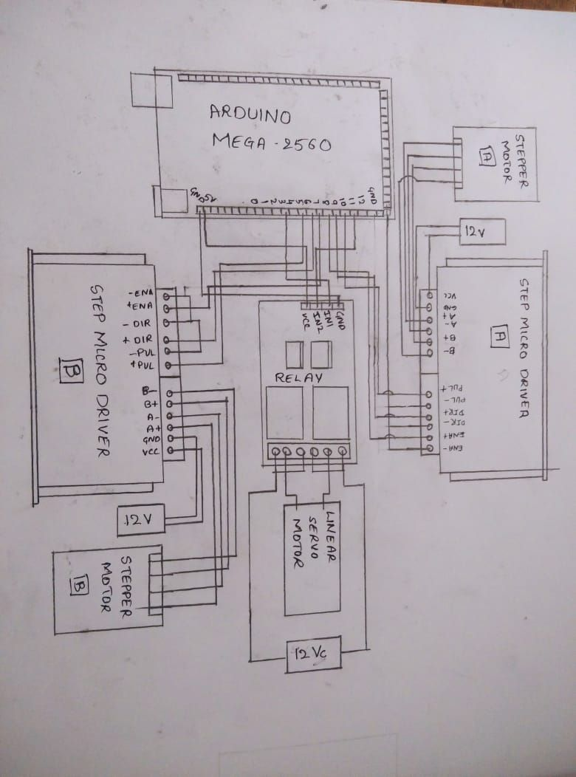
Circuit Diagram

Slide 20
Electronic Components Used
SL.NO | COMPONENTS | QUANTITY USED
1. | Arduino Mega 2560. | 1
2. | Stepper motor(NEMA17). | 2
3. | Micro step driver(TB6600). | 3
4. | Linear servo motor. | 1
5. | Relay. | 1
6. | Battery (DC supply of 12v) | 3

Slide 21
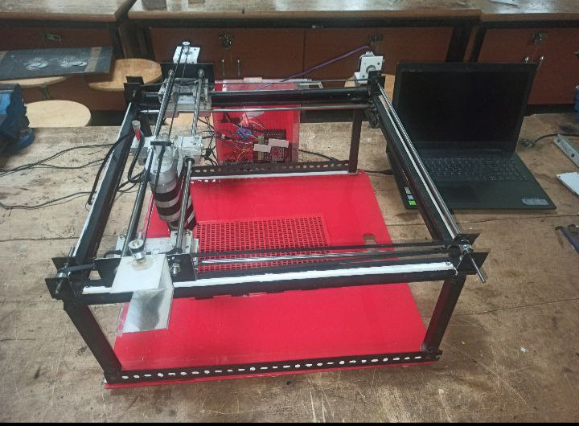
Final Product Photos

Slide 22
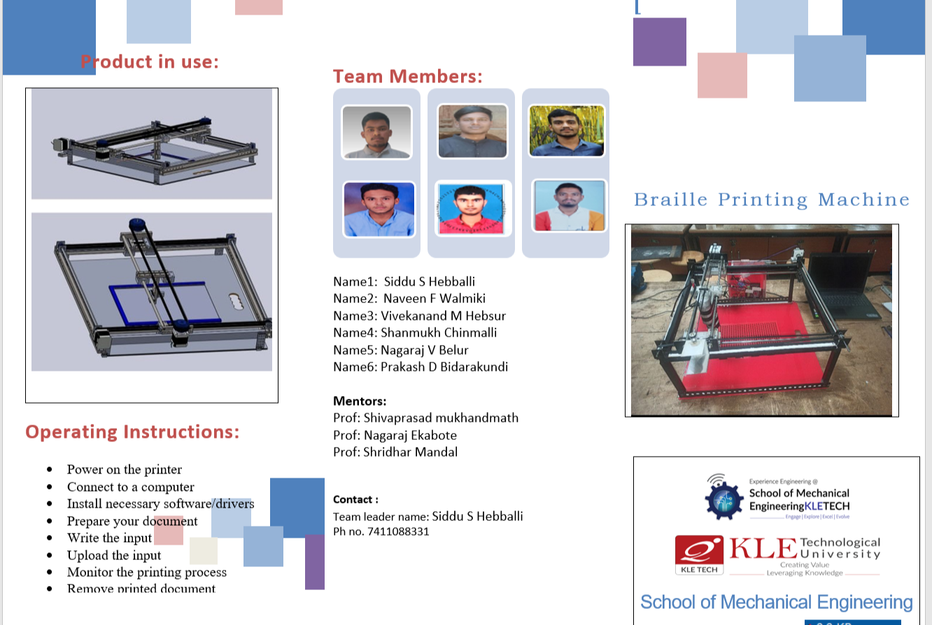
Product Catalogue

Slide 23
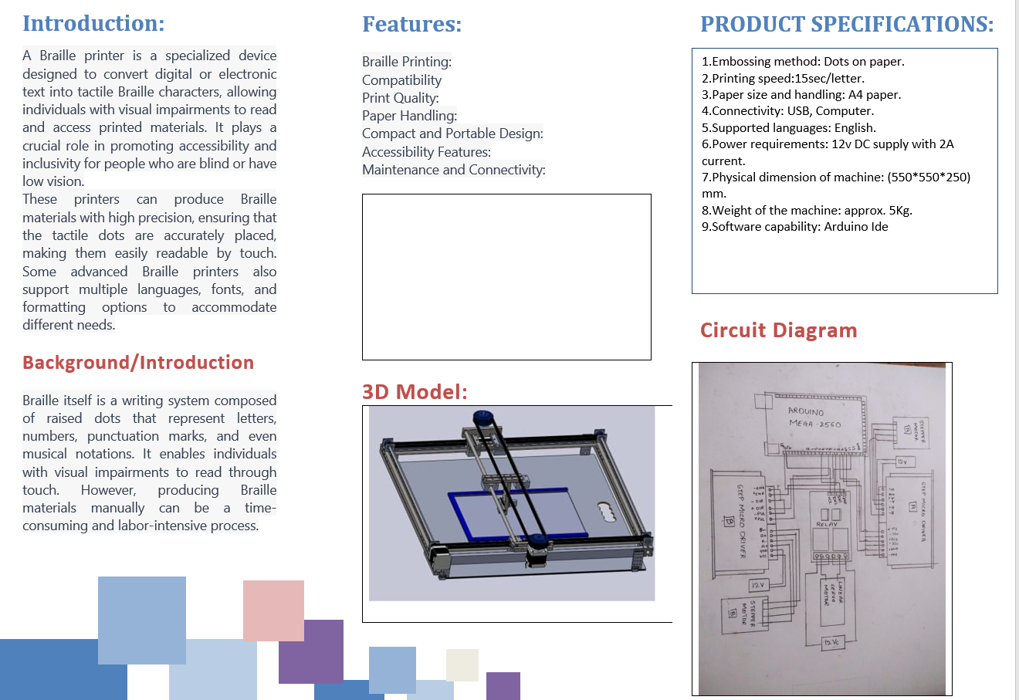

Slide 24
Thank You!!

